Slide 1
CONOP PACKET: Level 1 Approval
OPERATION:
CONOP Approval Level / Justification
1
Mission Statement
Location
PROVINCE:
DISTRICT:
TOWN:
MGRS:
JPEL TGT #:
TIER:
CONOP LEVEL Level 0 Level 2
Level 1
Unit operations that are less than a battalion size, with an
overall mitigated risk of moderate or lower (both operations and aviation operations), a low to moderate
risk of negative political, press or IO impacts and fully
resourced within the capabilities of the unit.
Unit operations that are battalion sized or have overall
mitigated risk of high (both operations and aviation
operations) or a moderate risk of negative political,
press or IO impacts or resources required exceed the
capabilities of the unit’s task or capability.
Unit operations that are larger than a battalion or have
an overall mitigated risk of Very High (both operations
and aviation operations) or a high risk of negative
political, press or IO impacts or requires resources
from XXX level or host nation.
DEFINITION
• BN CDR’s mitigated risk assessment is moderate or lower
• Aviation mitigated risk assessment is moderate or low
• Less than a Battalion size
• Pre-planned ordnance drops less than 155mm
• Does not require resources from outside the task
organization
• No pre-planned Forced Entry
• Limited Visibility Operations
• Is not a kill / capture of individual HVT/HVI/MVT
• Less than a Company – size force inside 1km zone in the
east; 10km zone in the west conducting security or
reconnaissance operations
• Use of non – up armored vehicles
• Level 1 CLPs
• BN CDR’s mitigated risk assessment is high
• Aviation mitigated risk is high
• Pre-planned ordnance drops that exceed 155mm
• Require resources from outside the task organization but
within division
• Use of non – standard HLZs that do not meet the
minimum standard*
• No pre-planned Forced Entry
• Deliberate Limited Visibility Operation involving a search
• Is not a kill / capture of individual HVT/HVI/MVT
• Objective contains known MVTs
• Any “RED” assessments on the criteria established by
division
• Any operation not tied to the division’s Lines of Operation
• Less than a Company – sized force inside 1kn zone in the
east; 10km zone in west conducting offensive operations
• BCT CDR’s mitigated risk assessment is very high
• Aviation mitigated risk is very high
• BN TF, ODB, or larger operation
• Requires resources from outside the task organization
and outside division
• Deliberate Pre-planned Forced Entry
• Intent is kill / capture individual HVT/HVI/MVT
• Objective contains known HPTs
• Multiple “RED” assessment on 12 criteria established by
division
• Host nation official involved as potential target
• Company size force or larger within the 1km zone in the
east; 10km zone in the west
CONDITIONS
BCT REVIEW or CDR APPROVAL
• Submitted to BCT DCHOPS 12hrs prior to execution
• Copy sent to G3 CHOPS 8hrs prior to execution
• AMR, ASR, ISR, EW Burn request submitted to BCT
DCHOPs 48hrs prior to execution
• Level 1 CLPs are briefed to CDR 48hrs prior to execution
CDR APPROVES
• Submitted to BCT DCHOPS 24hrs prior to execution
• Copy sent to G3 CHOPS 15hrs prior to execution
• AMR, ASR, ISR, EW Burn request submitted to BCT
DCHOPs 48hrs prior to execution
• Briefed to two-star level 24hrs prior to execution
• Briefed to three-star level 12hrs prior to execution
CDR APPROVES
• Submitted to BCT DCHOPS 48hrs prior to execution
• Copy sent to CHOPS G3 27hrs prior to execution
• AMR, ASR, ISR, EW Burn request submitted to BCT
DCHOPs / Staff proponents 48hrs prior to execution
• Briefed to two-star 36hrs prior to execution
• Briefed to three-star level 24hrs prior to execution
APPROVAL
CONDITION STATUS COMMENTS
ASSETS REQUESTED
Weather / Illum.
Green: Projected weather supports required ISR
Aviation
YES
NO
Intel
Green: Intelligence is believed valid and actionable for the target
CAS
YES
NO
ISR
Green: ISR platforms are scheduled and capable for mission support
CCA
YES
NO
Maneuver
Green: Combat forces are available and require no outside augmentation
ISR
YES
NO
Fires / Effects
Green: Fire support in range of target area and infil / exfil routes
Other:
(Specify)
IO
Green: IO themes are developed and synchronized with scheme of maneuver
Sustainment
Green: Adequate supplies are services available to support the mission MEDEVAC
plan is developed and synchronized with scheme of maneuver
Approval Level: DIV CDR
C2
Green: Primary and alternate communication systems are established and in place
C2 node(s) established and in place
Approved by: DIV CDR – YES / NO

Slide 2
Host Nation Government Conditions Assessment
CONDITION STATUS COMMENT
1) COCOM approval required before the arrest, apprehension, or detainment of a
current or former member of parliament or president appointed government official.
Gain division approval before the arrest, apprehension, or detainment of a
district-level government official.
Green: No government officials targeted
2) Conduct coordination with local government officials and tribal leaders when
conducting searches
Green: All searches will be conducted by host nation after talking to local officials.
Local officials will be briefed prior to any searches
3) Ensure the return of materials / documents taken during searches, unless the
owner is detained and the property becomes evidence.
Green: All non-intelligence related materials will be returned
4) Ensure personnel receive training on local customs and courtesies prior to
conducting authorized searches.
Green: All Soldiers will review local customs and courtesies, and rehearse
operations prior to execution
5) Ensure Soldiers conducting searches ask for doors to be opened by occupants
rather than Soldiers forcing entry.
Green: XXXX will lead and conduct all searches IAW policy. Planned soft-knock of
target house.
6) Avoid the cuffing or binding of hands, unless required for security
Green: Anyone detained will be restrained with the least amount of force necessary
to provide local officials in secure environment
7) During low risk operations, use a local person to enter the home or business of
the person to be searched to explain what is happening
Green: Interpreters will ensure situational awareness of non-combat civilians on the OBJ. IO themes will begin during actions on the OBJ.
8) Conduct of night searches, hard-knock or soft-knock, will require prior approval by
Commander XXXXX
Green: HVI Patterns do not require night time operations
9) Ensure there is an infusion of reconstruction funds to areas where local people
were detained and subsequently released
Green: Detailed CMO projects planned for all operations
10) Sustain the use of interpreters for direct interpretation while conducting raid or
detaining local government personnel
Green: Interpreters will be assigned for duration of mission and will be used for TQ.
Level 2 interpreters will assist with TQ.
11) Kill or Capture Operation
Green: Planned Kill or Capture mission of HVT
12) Within the 10km zone along the international border
Green: Planned operations and daily patrols and force protection operations will not
occur within 10km from the international border.

Slide 3
CONOP PACKET: Recent Reporting
HUMINT:
MAP
SIGNINT:
S2 Assessment:

Slide 4
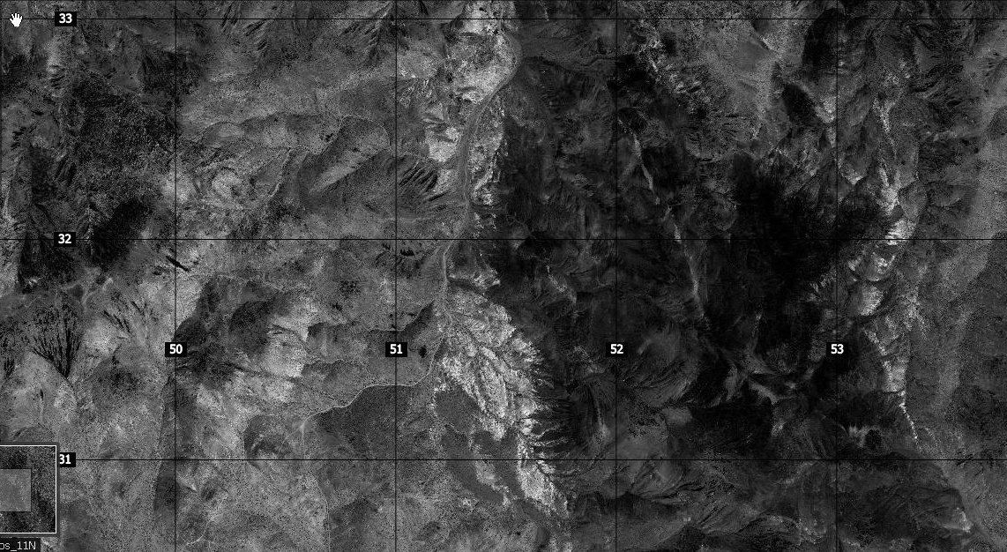
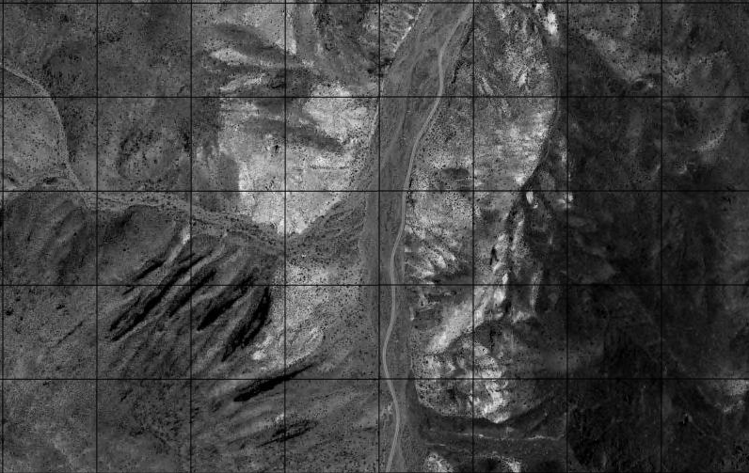
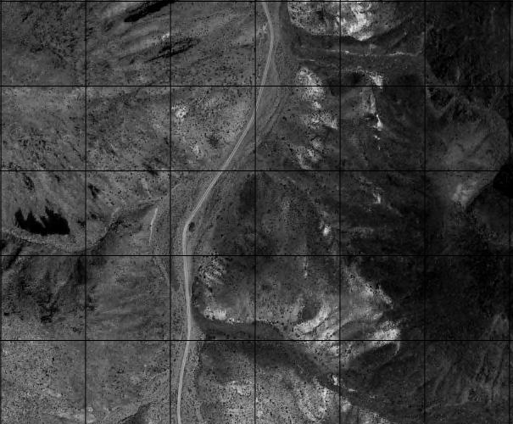
OPERATION (MDCOA) SITUATION TEMPLATE – (GRID)
EA 2
IED
IED
EA 1
IED
Example
IED
ENEMY MDCOA:
Tasks:
Purpose:
Method:
End state:
Estimated Enemy
Disposition and Composition
IED
Key:
IED
Mortar
AK-47
MMG
HMG
RPG
OP
IDF
HQ

Slide 5
OPERATION (MLCOA) SITUATION TEMPLATE – (GRID)
IED
EA 2
EA 1
IED
IED
Example
ENEMY MLCOA:
Tasks:
Purpose:
Method:
End state:
Estimated Enemy
Disposition and Composition
IED
Key:
IED
Mortar
AK-47
MMG
HMG
RPG
OP
IDF
HQ

Slide 6
CONOP PACKET: Concept of the Operation
KEY INFORMATION
Operation Priority Supported:
Personnel:
Host Nation Personnel:
# of Vehicles:
# of Aircraft:
Pre-Planned Fires:
Nearest City:
Central Grid:
Planned Start Date:
Planned End Date:
PAO Assessment:
Size of Mission:
MAP
C2 Element and Location:
Commanders Intent:
Method (Key Tasks):
T1:
T2:
T3:
Purpose:
End state:
Friendly Situation:
Political Impact to Area:
Mission:

Slide 7
CONOP PACKET: Scheme of Maneuver (Phase I)
Task Organization:
MAP
Requested Enablers:
Enemy Concept:
Friendly Concept – Phase I:

Slide 8
CONOP PACKET: Scheme of Maneuver (Phase II)
Task Organization:
MAP
Requested Enablers:
Enemy Concept:
Friendly Concept – Phase II:

Slide 9
CONOP PACKET: Scheme of Maneuver (Phase III)
Task Organization:
MAP
Requested Enablers:
Enemy Concept:
Friendly Concept – Phase III:

Slide 10
CONOP PACKET: Scheme of Maneuver (Phase IV)
Task Organization:
MAP
Requested Enablers:
Enemy Concept:
Friendly Concept – Phase IV:

Slide 11
CONOP PACKET: Coordinating Instructions
Coordinating Instructions:
Enablers:
Partnership:
TSE:
MAP
Risk/Consequence Management:
OBJ AREA
Service and Support:
Timeline:
Command and Signal:
Mission:

Slide 12
Risk Assessment
INSERT RISK ASSESSMENT

