Slide 1
Intelligence Gunnery Concept
DD MMM YYYY

Slide 2
Intelligence Gunnery Concept
MI Gunnery terminology and gated/table strategy being designed to resemble the Army’s Integrated Weapons Training Strategy.
Intelligence Warfighting Function:
S2 (BDE & BNs) + S2X + BICE + Collection Assets
Platform: The combination of a weapon system and a mobility system…for MI a platform will equate to the collaboration of two or more crews to perform a discipline activity.
NOTE: Individual, Crew, and Platform definitions nest with the Army‘s Objective T definitions.
Tier1
IWfF
Certification
HCTs + OMT = HUMINT Platform
CST + Prophet = SIGINT Platform
TGS + UAV = GEOINT Platform
S2 + All Source + CM + TGT = Analysis Platform
Tier 2
Platform
Certification
Crew: Consists of two or more individuals who perform a specific enduring set of critical intelligence collection or analytical tasks (i.e. HCTs, Prophet Teams, IEW Section, Analysis Production Section).
Tier 3
Crew Certification
Tier 4
Individual Certification
Individual: All soldiers of a given MOS within the BCT will conduct Gate 4 annually.

Slide 3
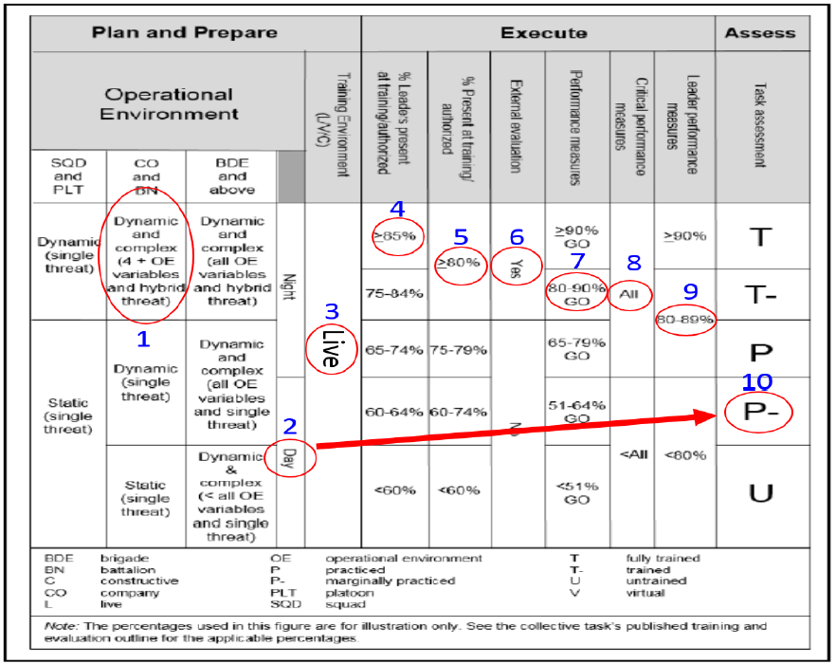
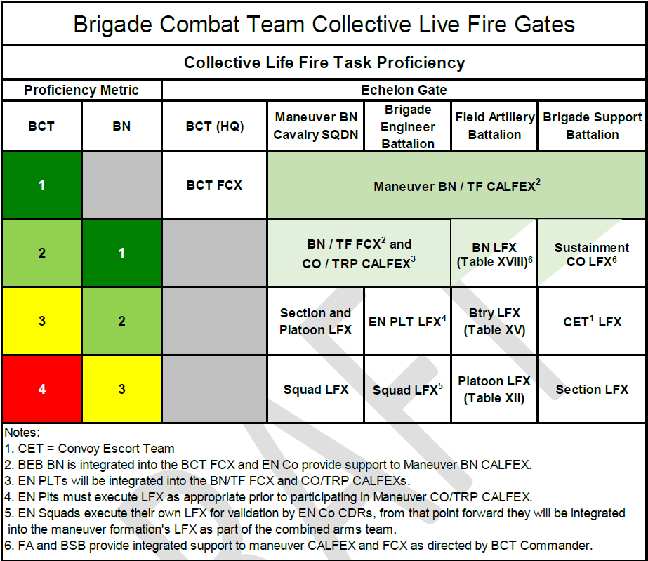
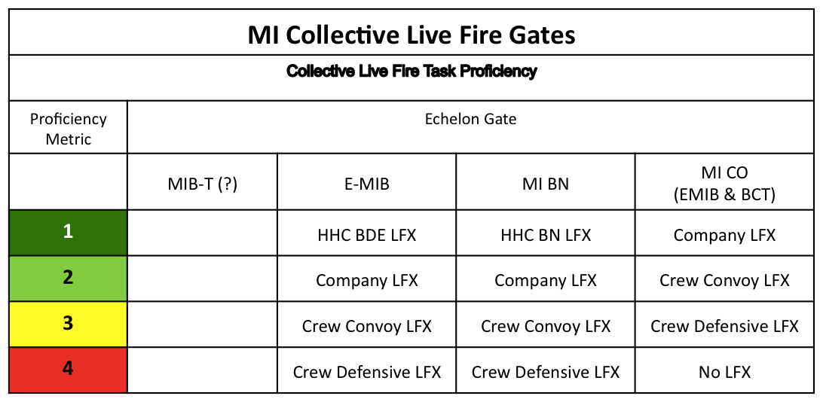
Intelligence Gunnery Concept
Current challenge: BCT commanders are senior trainers for all WFFs
IWFF owes: An integrated weapons training strategy (clear training, cert standards using the intel lexicon and gated training construct)
Maneuver Units Report…
Intelligence Units Report…**
Tier 4
Tier 3
Tier4
Tier3
Individual | Crew Serve | Platform
M4: 105/115 M9: 2/2 M249: 18/18 Shotgun: 13/18 M320A: 12/20 | M240B: 8/9 Mk19: 1/1 | M2A2: 14/14
150 /173= 87% | 9/10 = 90% | 14/14 = 100%
I/C/P Rating (87+90+100)/3 = 92%
Individual | Crew Serve | Platform
M4: 80/90 M9: 4/5 M249: 5/10 | M240B: 8/9 Mk19: 1/1 M2: 2/2 | N/A
89 /105= 85% | 10/12 = 83%
I/C/P Rating (85+83/2) = 84%
#1a. I/C/P Warrior Proficiency
“Table VI Stats”
IWTS Gunnery Tiers* MITS
BN LFX
CO LFX
Platform Crew Cert
Individual & Crew Served
1
2
3
4
IWFF Cert
MI Platform Cert
MI Crew Cert
Individual MOS Proficiency on POR
Tier 4
Tier 3
Tier 2
No Maneuver equivalent for non-weapon proficiency certification/reporting
This may be template for Non LFX OBJ-T units
Individual | MI Crews | Platform
35F: 10/15 35G: 4/5 35P/N: 7/8 35M: 15/15 35T: 3/3 | Prophet: 2/3 CST: 1/1 HCT: 2/3 CM: 1/1 AS: 1/1 | SIGINT: 1/1 HUMINT: 1/1 GEOINT: 1/1 Analysis: 0/1
39/46= 85% | 7/9 = 78% | 3/4 = 75%
I/C/P Rating (85+78+75)/3 = 79%
#1b. I/C/P MI Proficiency “MI Gunnery Table VI Stats”
OBJ-T: “ Four Components of Training Readiness”
MET Proficiency
≥ T- in all METs
≥ T- in 50% or greater of METs (No U)
≥ P in 50% or greater of METs (≤ 1 x U)
≤ P- in greater than 50% of METs (or > 1 x U)
Individual Qual: By MOS on POR system
Crew: MICO broken into 10 crews
Platform: end to end discipline capability (i.e. HCT + OMT)
Sets standards for “intel at the speed of Msn Cmd”
Focus on answering PIR/IR; “PIR are plywood”
Expeditionary ; sets/reps on establishing architecture
Builds muscle memory; speeds sensor to shooter link
#2 MET Proficiency
“Evals w/T&EOs”
#3 Collective LFX Proficiency
*Each gate has 6 tables; TBL VI is certification table
**Illustrative example; not all MOSs/Crews listed
*** All OBJ-T calculations are “Qualified/Required” not “assigned”
MITS = Military Intelligence Training Strategy
I/C/P = Individual/Crew/Platform

Slide 4
CLOSING COMMENTS

